Slide 1
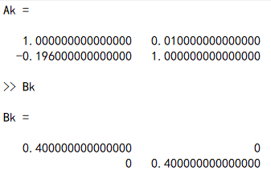
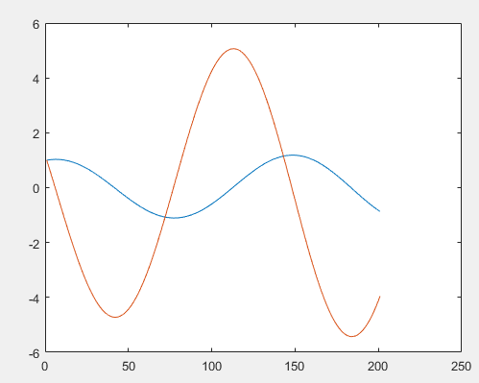
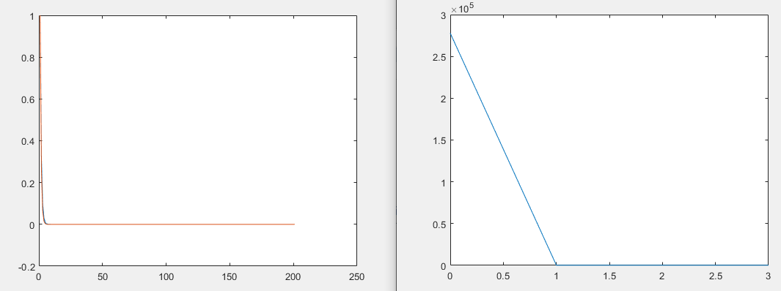
Ilqr+least square central difference sysid+LTI system
Weiwei li 2004
Initial trajectory
Ilqr trajectory
Ilqr cost

Slide 2
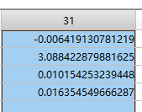
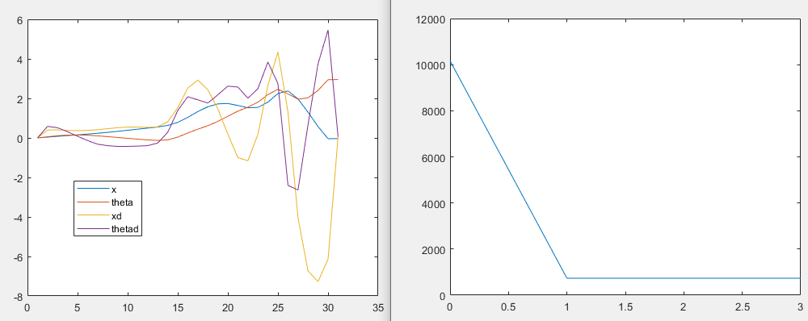
Ilqr+ Ltv cartpole + LSCD

Slide 3
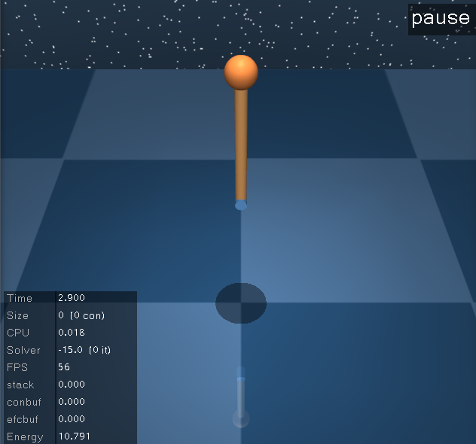
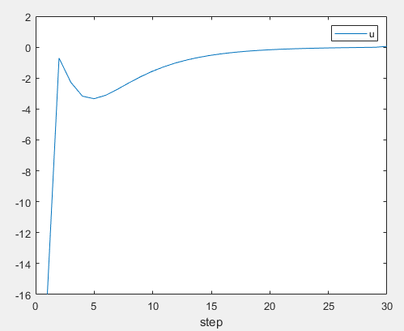
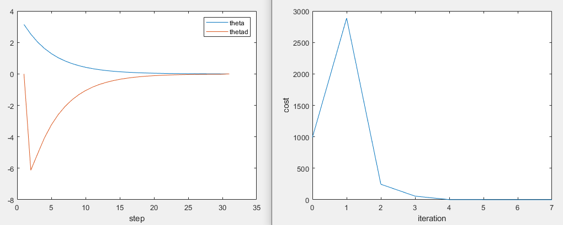
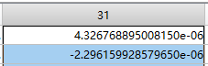
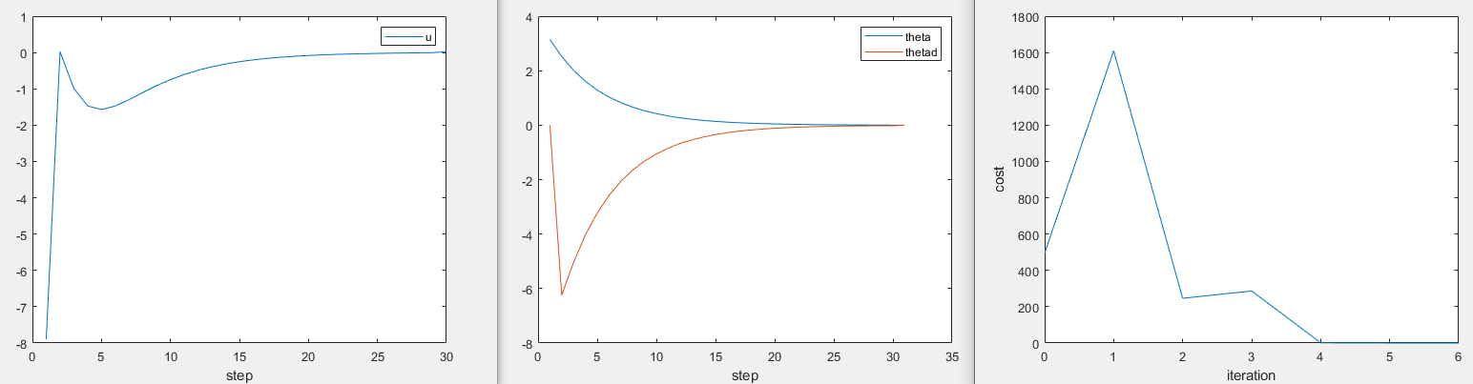
Ilqr+ pendulum + LSCD
Same cost as in Weiwei li paper
Add x-x_target to incremental cost, Q,R same

Slide 4
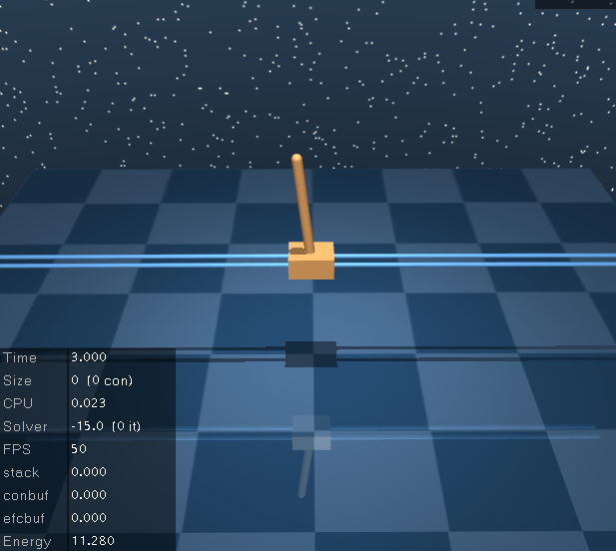
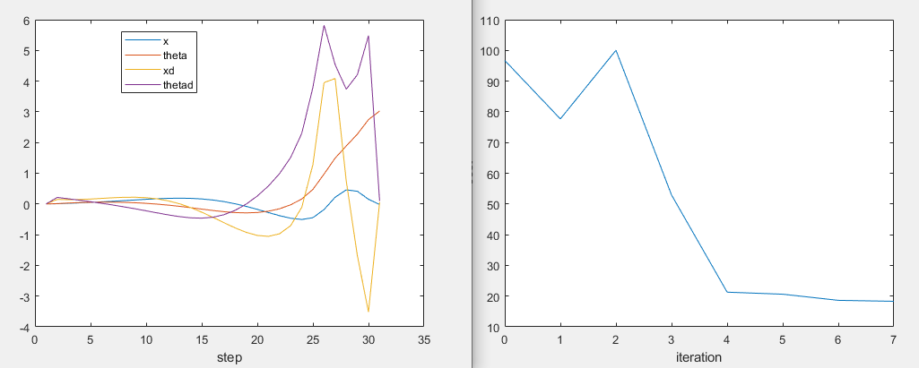
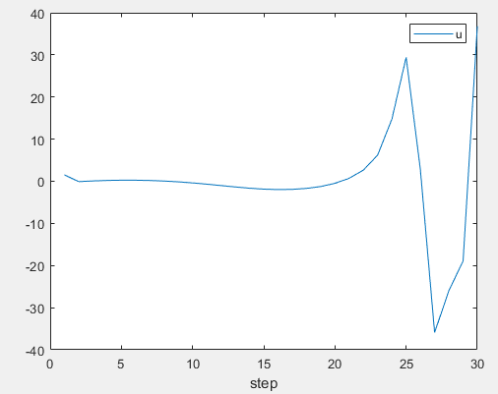
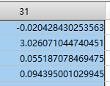
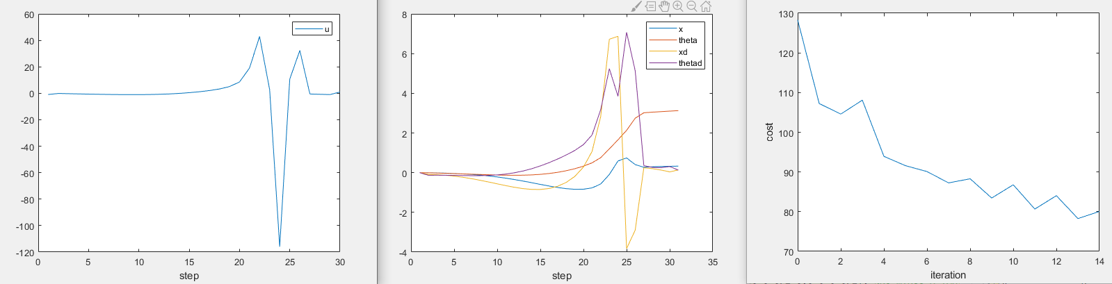
Ilqr+ cartpole + LSCD
Same cost as in Weiwei li paper
Add x-x_target to incremental cost

Slide 5
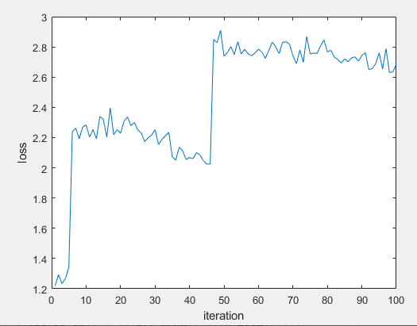
Spsa id

Slide 6
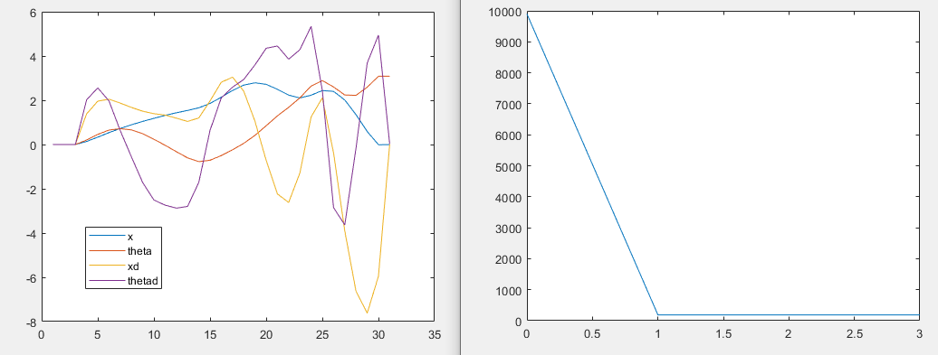
Ilqr+ Ltv cartpole + ARMA
C=I, qx=qu=1

Slide 7
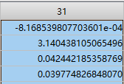
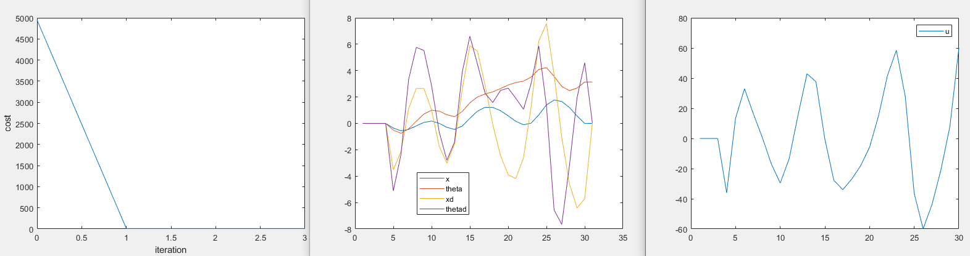
Ilqr+ Ltv cartpole + ARMA
C=pos only, qx=qu=2

Slide 8
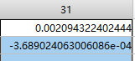
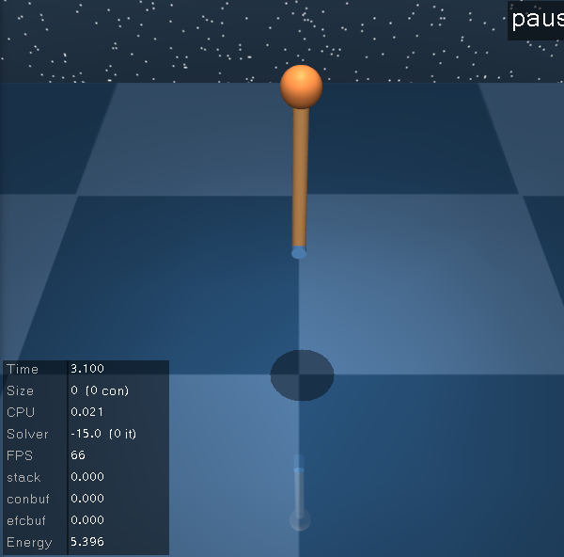
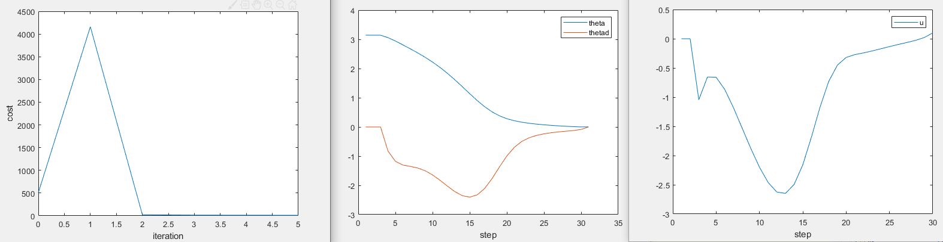
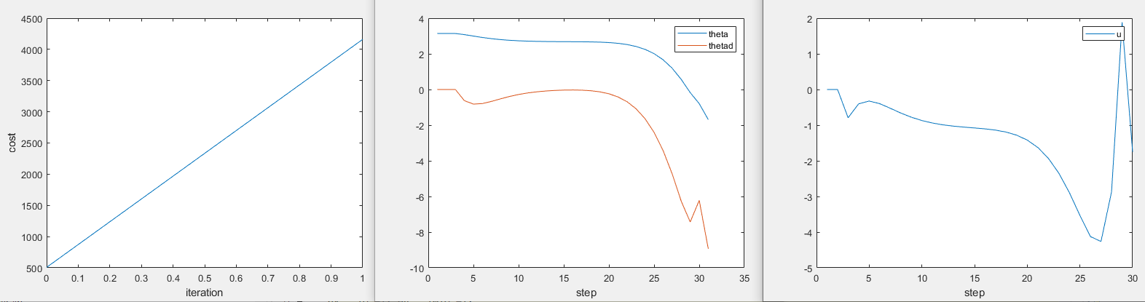
Ilqr+ pendulum+ ARMA
C=I, qx=qu=1

Slide 9
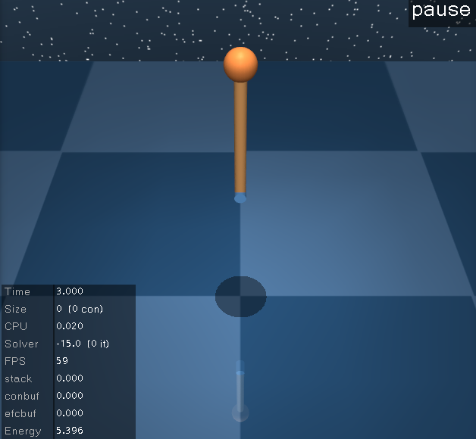
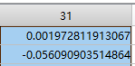
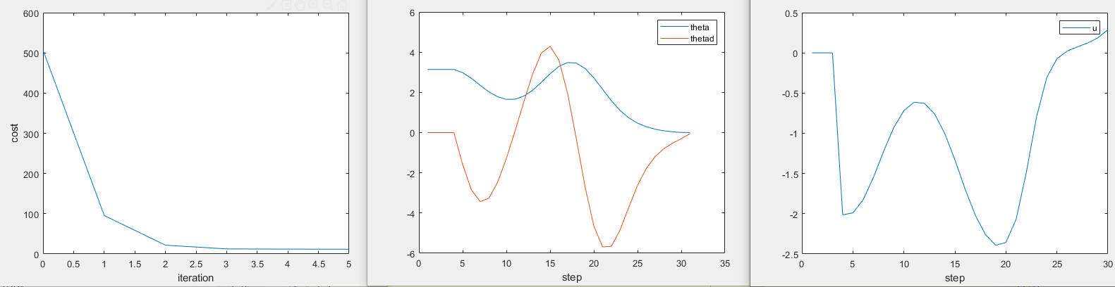
Ilqr+ pendulum+ ARMA
C=pos only, qx=qu=2

Slide 10
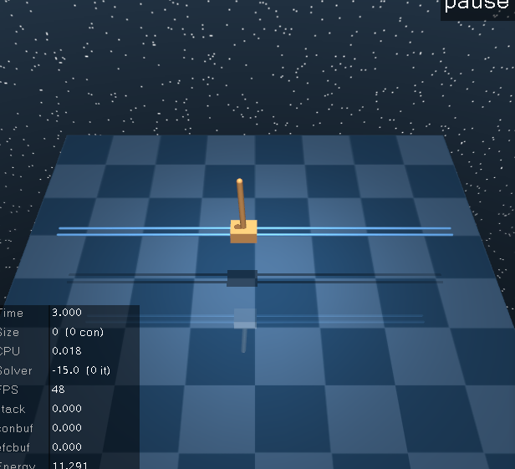
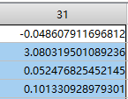
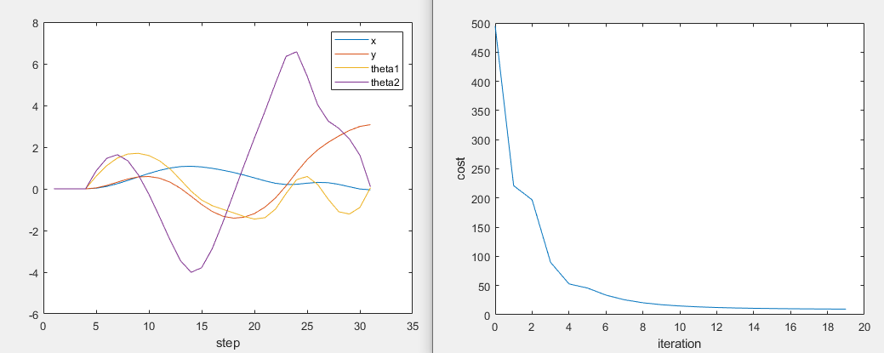
Ilqr+ cartpole+ ARMA
C=I, qx=qu=1

Slide 11
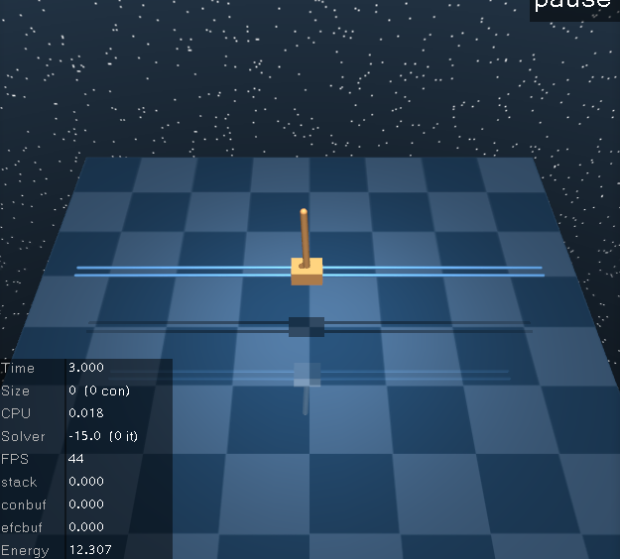
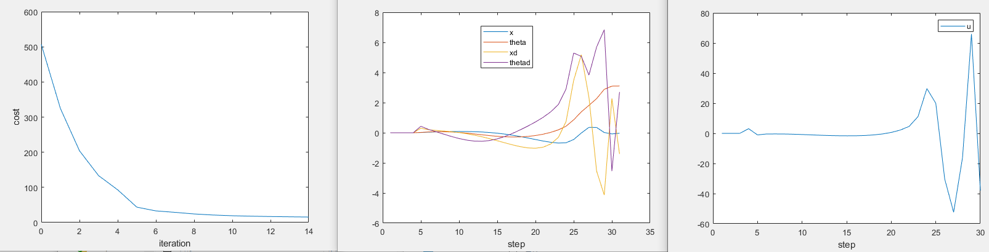
Ilqr+ cartpole+ ARMA
C=pos only, qx=qu=2

Slide 12
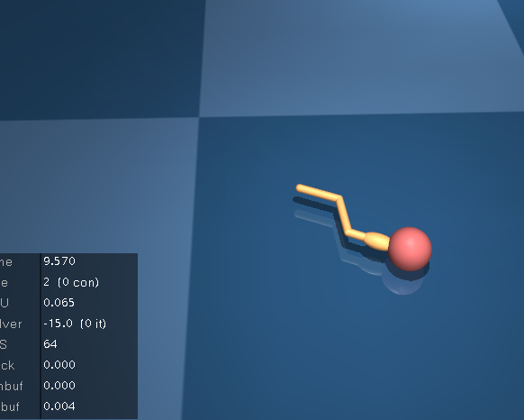
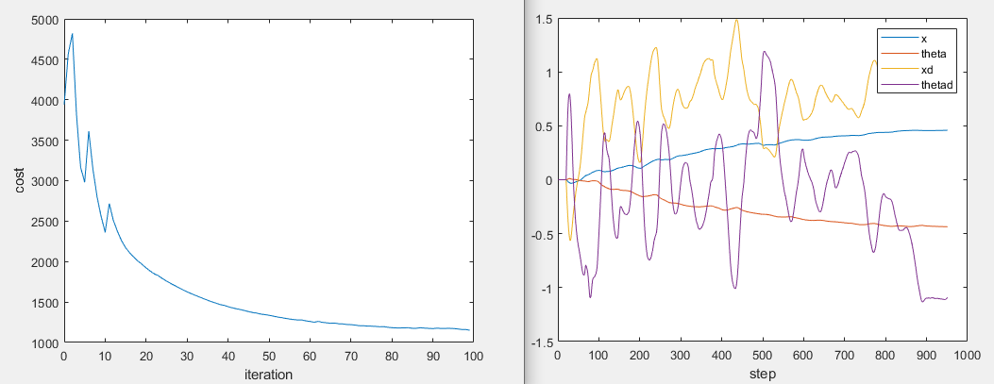
Ilqr+ swimmer3+ ARMA
C=I, qx=qu=1

Slide 13
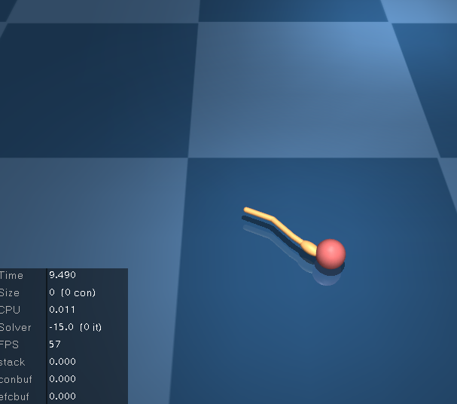
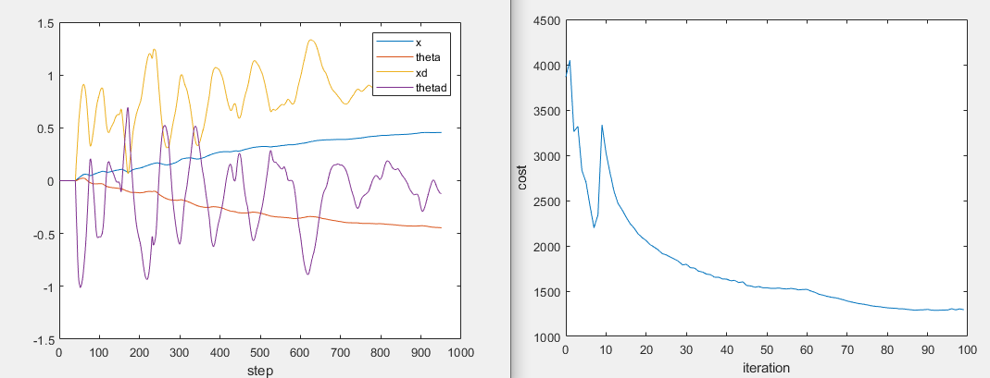
Ilqr+ swimmer3+ ARMA
Pos only, qx=qu=2

Slide 14
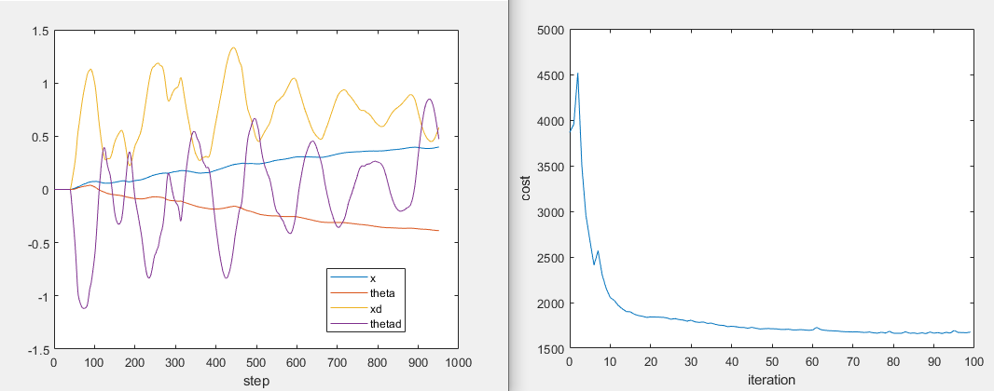
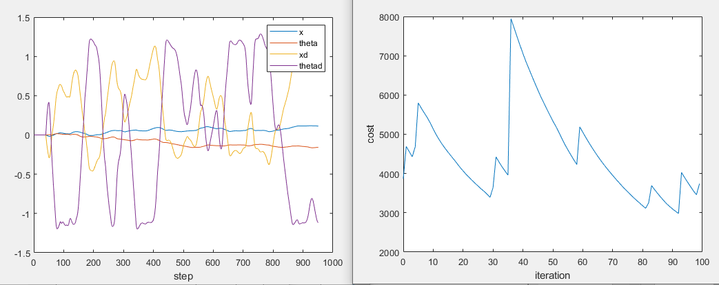
swimmer3
Alpha=0.9*alpha
Line search IROS12 paper

Slide 15
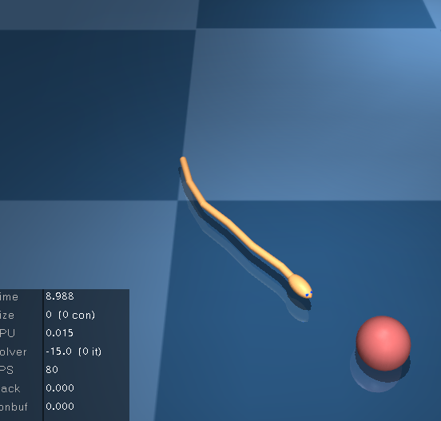
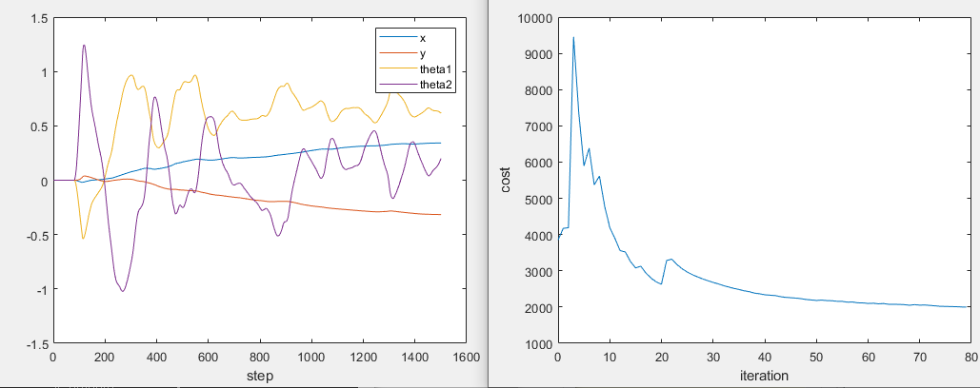
Ilqr+ swimmer6+ ARMA
C=I, qx=qu=1，no batching

Slide 16
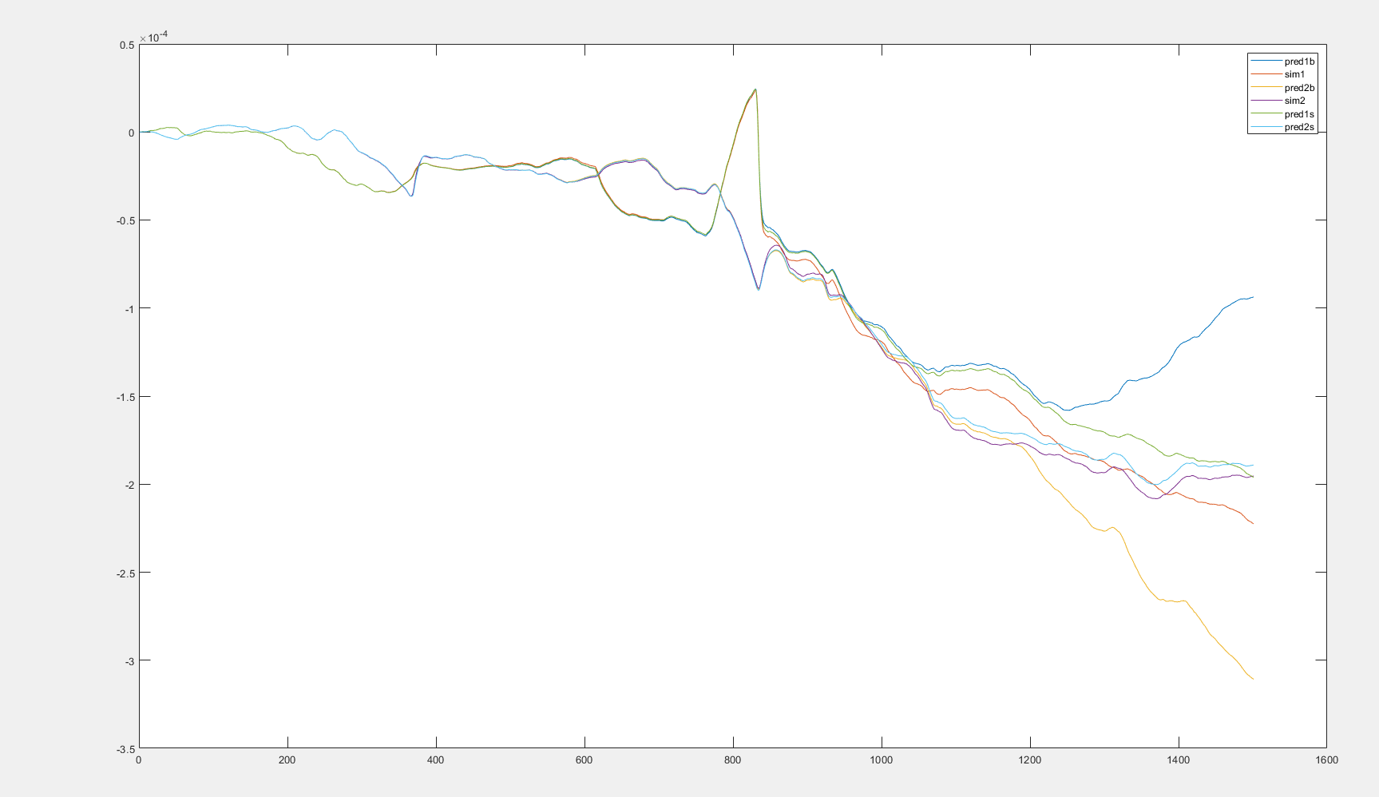
Batch=4
Skip 40 steps

Slide 17
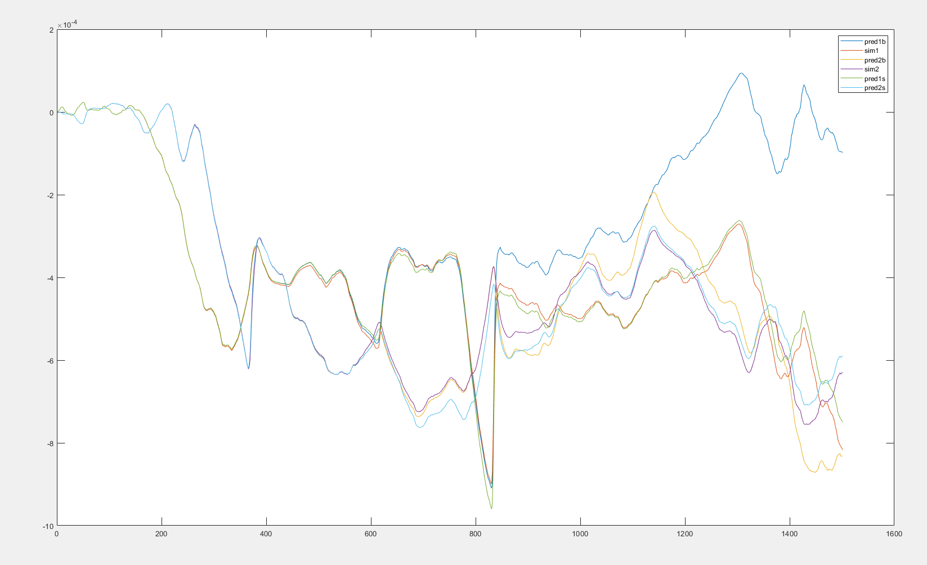
Batch=4
Skip 40 steps

Slide 18
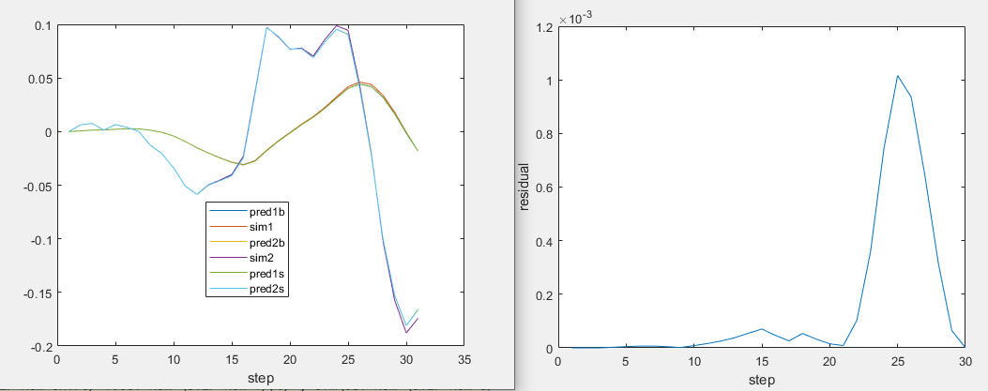
Pendulum+arma+single batch residual

Slide 19
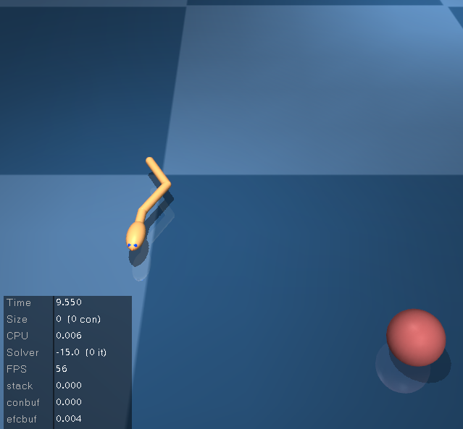
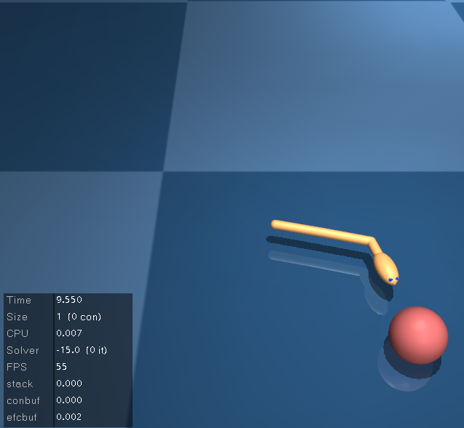
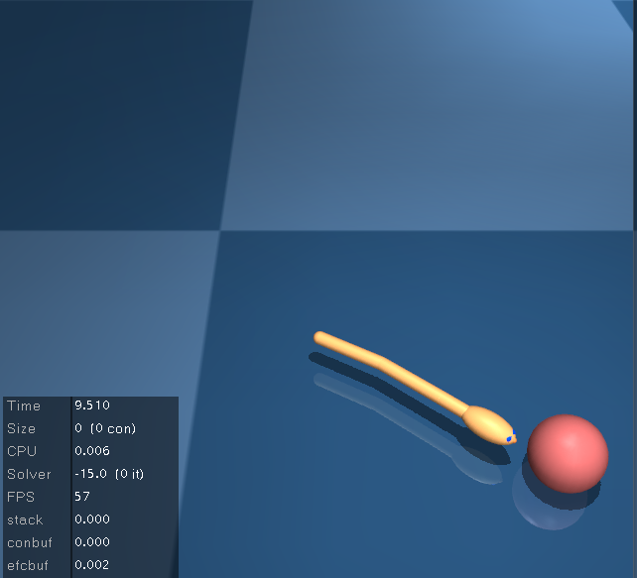
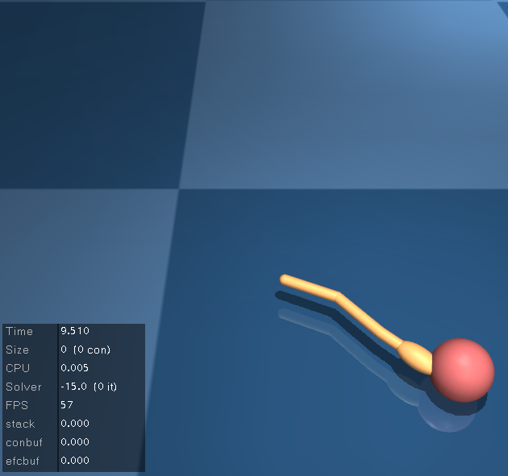
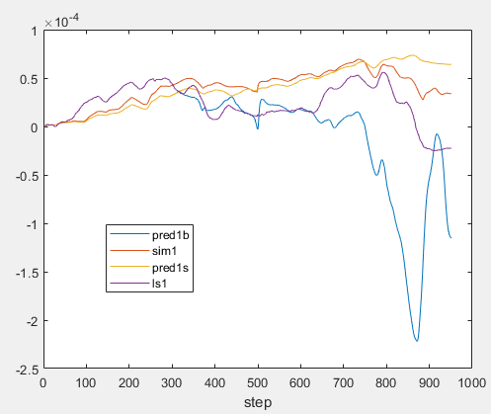
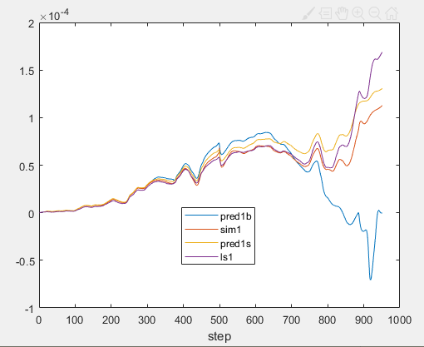
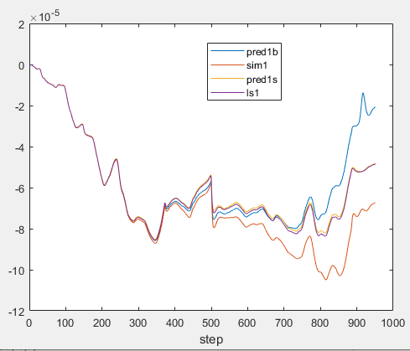
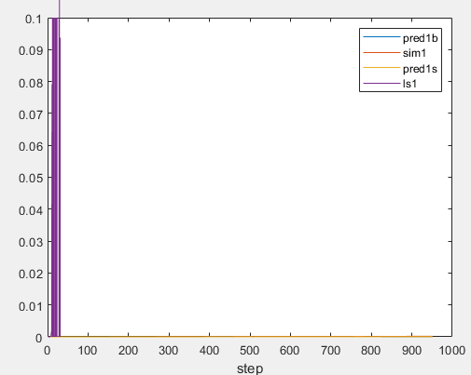
ID Noise=10% umax
ID Noise=1% umax
ID Noise=0.1% umax
ID Noise=0.01% umax
Test Noise=0.01% umax
100 rollouts
LS fails, single, batch similar

Slide 20



Test Noise=0.1% umax
100 rollouts
ID Noise=10% umax
Noise=1% umax
Noise=0.1% umax
Noise=0.01% umax

Slide 21
D2C 2.0 key settings
Initial guess
D2C2.0 training fails (error) without initial guess(s3,s6)
Matlab version (LS) converges but descents much slower
Add random noise as initial guess
2. Line search
IROS12 paper line search: fail to converge both python and matlab
alpha = alpha*0.9: can’t reach target but converge
D2C 2.0: works well, only need to decrease alpha in forward pass
3. Least square solver(matlab):
classic method: id perturbation var=e-6 can’t reach target, var= e-7,e-8 works well – need small perturbation
QR decomposition: var=e-6 works well, e-4 fails
4. Regularization never triggered in both
5. R should not be small

Slide 22


Ilqr+ swimmer6+ LSID matlab
C=I, qx=qu=1，all parameters are the same as d2c 2.0

Slide 23





Increase perturbation for the first few steps

Slide 24


Ilqr+ swimmer6+ ARMAID matlab
C=I, qx=qu=1

Slide 25


Ilqr+ swimmer6+ ARMAID matlab
C=pos only, qx=qu=2

Slide 26




Umax=7
ID Noise=10% umax
ID Noise=1% umax
Test Noise=1% umax
100 rollouts

Slide 27


Add control truncation in ARMA id perturbation
Add control truncation in ARMA id perturbation and prediction perturbation

Slide 28


Ilqr+ dbar3d+ ARMAID matlab
C=I, qx=qu=1
With control truncation

Slide 29


Ilqr+ dbar3d+ ARMAID matlab
C=pos only, qx=qu=2
With control truncation

Slide 30


Ilqr+ dbar3d+ ARMAID matlab
C=first 2 nodes pos only, qx=qu=2
With control truncation
Need more rollouts in the ARMA fitting
Ilqr+ dbar3d+ ARMAID matlab
C=first 2 nodes pos only, qx=qu=3
With control truncation

Slide 31


Ilqr+ t1d1_3d+ ARMAID matlab
C=I, qx=qu=1
With control truncation

Slide 32


Ilqr+ t1d1_3d+ ARMAID matlab
C=I, qx=qu=1
With proposed control limit

Slide 33


Ilqr+ t1d1_3d+ ARMAID matlab
C=pos only, qx=qu=2
With control truncation

Slide 34


Ilqr+ t2d1_3d+ ARMAID matlab
C=I, qx=qu=1
With control truncation

Slide 35


Ilqr+ t2d1_3d+ ARMAID matlab
C=pos only, qx=qu=2
With control truncation

Slide 36


Ilqr+ dbar3d+ ARMAID matlab
C=I, qx=qu=1
With proposed control limit+prestress
0 stiffness

Slide 37
No slack strings
Use prestress as initial guess + none zero tension limit(truncation)
Current setup
Tendon stiffness: 0
Control variable: tension
Issue
Simulation sensitive to inaccuracy (not stable equilibrium)
Need stiffness
Directly add tendon stiffness in the mujoco model
Or simulate the tension from elongation in software
Simulation stable (stable equilibrium)
Energy waste in ilqr result (strings connected to the floor)
Ilqr result fails to reach target (wave up and down)
Solution 1
Put some stiffness in the mujoco model
Apply prestress tension calculated from matlab
Wait until it becomes stable (enter equilibrium point)
Calculate the tension from elongation (stiffness*(current length-initial length))
Initial guess is prestress + tension from elongation
Remove the stiffness in mujoco model and do ilqr

Slide 38



Add stiffness in the model and control the rest length
Simulation stable (stable equilibrium)
No energy waste from stiffness
Solution 2
Add tendon stiffness in the mujoco model
Change control variable to rest length
Transform prestress tension to rest length in matlab and use as initial guess for ilqr
Truncate rest length < current length (tendon is a spring)
Change control cost to constrain rest length-initial rest length
New t1d1_3d model
Stable with initial prestress
ARMAID with u = rest length

Slide 39


Ilqr+ dbar3d+ ARMAID matlab
C=I, qx=qu=1
With control truncation+prestress
Control rest length (applied solution 2)
Stiffness=100

Slide 40


Ilqr+ t1d1_3d+ ARMAID matlab
C=I, qx=qu=1
With control truncation+prestress
Control rest length (applied solution 2)
Stiffness=100

Slide 41


Slide 42


Slide 43




s6
cartpole
Small miu
miu = 100
miu = 10^6

Slide 44




cartpole
Miu=0
Miu=1000
Miu=20
Miu=50

Slide 45

Cartpole
Increase R to 1, miu=10
retrain

Slide 46


Nominal: R=20, umax=10
DDP:R=0.05 miu=10 otherwise umax is too large

Slide 47


cartpole
Miu=0 R=20 train+DDP
2000 rollouts

Slide 48


cartpole
pendulum

Slide 49




S6 miu=0 R = 0.005
miu=100 R = 100
DDP:miu=100 R = 100 ilqr:miu=0,R=0.005
DDP:miu=100 R = 100 ilqr:miu=100,R=100

Slide 50


s6
DDP:miu=1000 R = 0.005 idnoisestd=0.01 or 0.00001 100000rollouts
DDP has much higher variance and mean than lqr

Slide 51



Miu=100 R=10
Miu=1000 R=20
Fish
DDP:Miu=1000 R=20
ILQR:miu=0 R=0.05

Slide 52



Fish
Miu=1000 R=20
X-axis % of umax=5.3
Ddp increased miu and R
Ilqr original small miu and R

Slide 53


pendulum
miu=0,R=0.01,2000rollouts
miu=20,R=0.01,2000rollouts

Slide 54

pendulum
DDP:miu=0,R=0.01,2000rollouts

Slide 55




10 rollouts for fxx id
50 rollouts for fxx id
100 rollouts for fxx id
1000 rollouts for fxx id
Need O((ns+nu)^2) rollouts
Cartpole
ns=4, nu=1
Tested under 10% umax noise

Slide 56




S6 ns=16, nu=5 Tested under 10%umax noise
Id noise std=0.01
400 rollouts for fxx id
Residual e-3, max cond=628
2000 rollouts for fxx id
Residual e-3, max cond=63
5000 rollouts for fxx id
Residual e-3, max cond=41
20000 rollouts for fxx id
Residual e-3, max cond=30

Slide 57


5000 rollouts for fxx id
Residual e-18, max cond=41
Idnoise std e-5
5000 rollouts for fxx id
Residual e-6, max cond=41
Idnoise std e-3
5000 rollouts for fxx id
Residual 0.7, max cond=41
Idnoise std e-1
Tested under 10%umax noise

Slide 58








Cartpole 1000 rollouts
1% noise
10% noise
30% noise
100% noise
Swimmer6 50000 rollouts
ns=16，nu=5
1% noise
10% noise
30% noise
100% noise

Slide 59









pendulum
Fx id perturbation e-4, 50 rollouts
Fxx id 2000 rollouts
Fxx id perturbation e-10
Residual e-30, mcond 6
Fxx id perturbation e-6
Residual e-30, mcond 6
Fxx id perturbation e-3
Residual e-24, mcond 6
Fxx id perturbation e-1
Residual 11, mcond 6
Quu not pd
Quu not pd
50%
200%

Slide 60








pendulum
Fx id perturbation e-4, 50 rollouts
Fxx id 2000 rollouts
Fxx id perturbation e0
Residual 15, mcond 6
Fxx id perturbation e1
Residual 17, mcond 6
Fxx id perturbation e2
Residual 18, mcond 6
Quu not pd
50%
200%

Slide 61










Cartpole
Fx id perturbation e-4, 100 rollouts
Fxx id 2000 rollouts
Fxx id perturbation e-8
Residual e-30, mcond 9
Fxx id perturbation e-5
Residual e-30, mcond 10
Fxx id perturbation e-3
Residual e-24, mcond 9
Fxx id perturbation e-1
Residual e-8, mcond 11
Quu not pd
10%
70%

Slide 62










Cartpole
Fx id perturbation e-4, 100 rollouts
Fxx id 2000 rollouts
Fxx id perturbation e0
Residual 0.2, mcond 9
Fxx id perturbation e1
Residual 259, mcond 9
Fxx id perturbation e2
Residual 36000, mcond 9
Fxx id perturbation e3
Residual 36000, mcond 9
Quu not pd
10%
70%

Slide 63


No reset
Miu=100

